Slide 1
Game AI with
Statistical Forward Planning
Simon Lucas and the Game AI Group

Slide 2
Statistical Forward Planning: The ‘Algorithm’
Simulate many possible futures (based on possible action sequences)
Pick the one we like best
Rapidly adaptive
Highly tunable
Explainable

Slide 3
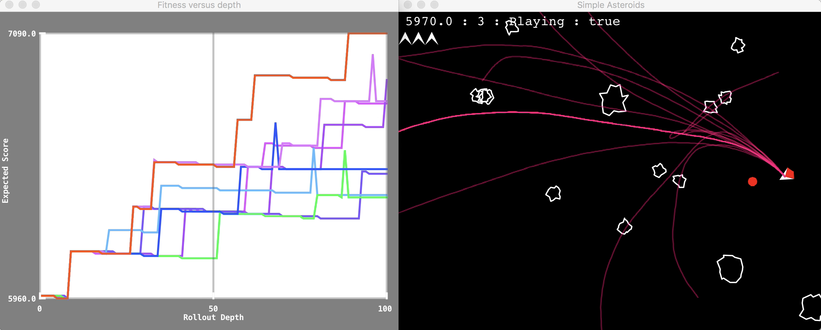
SFP: Rolling Horizon Evolution in Asteroids See Demo

Slide 4
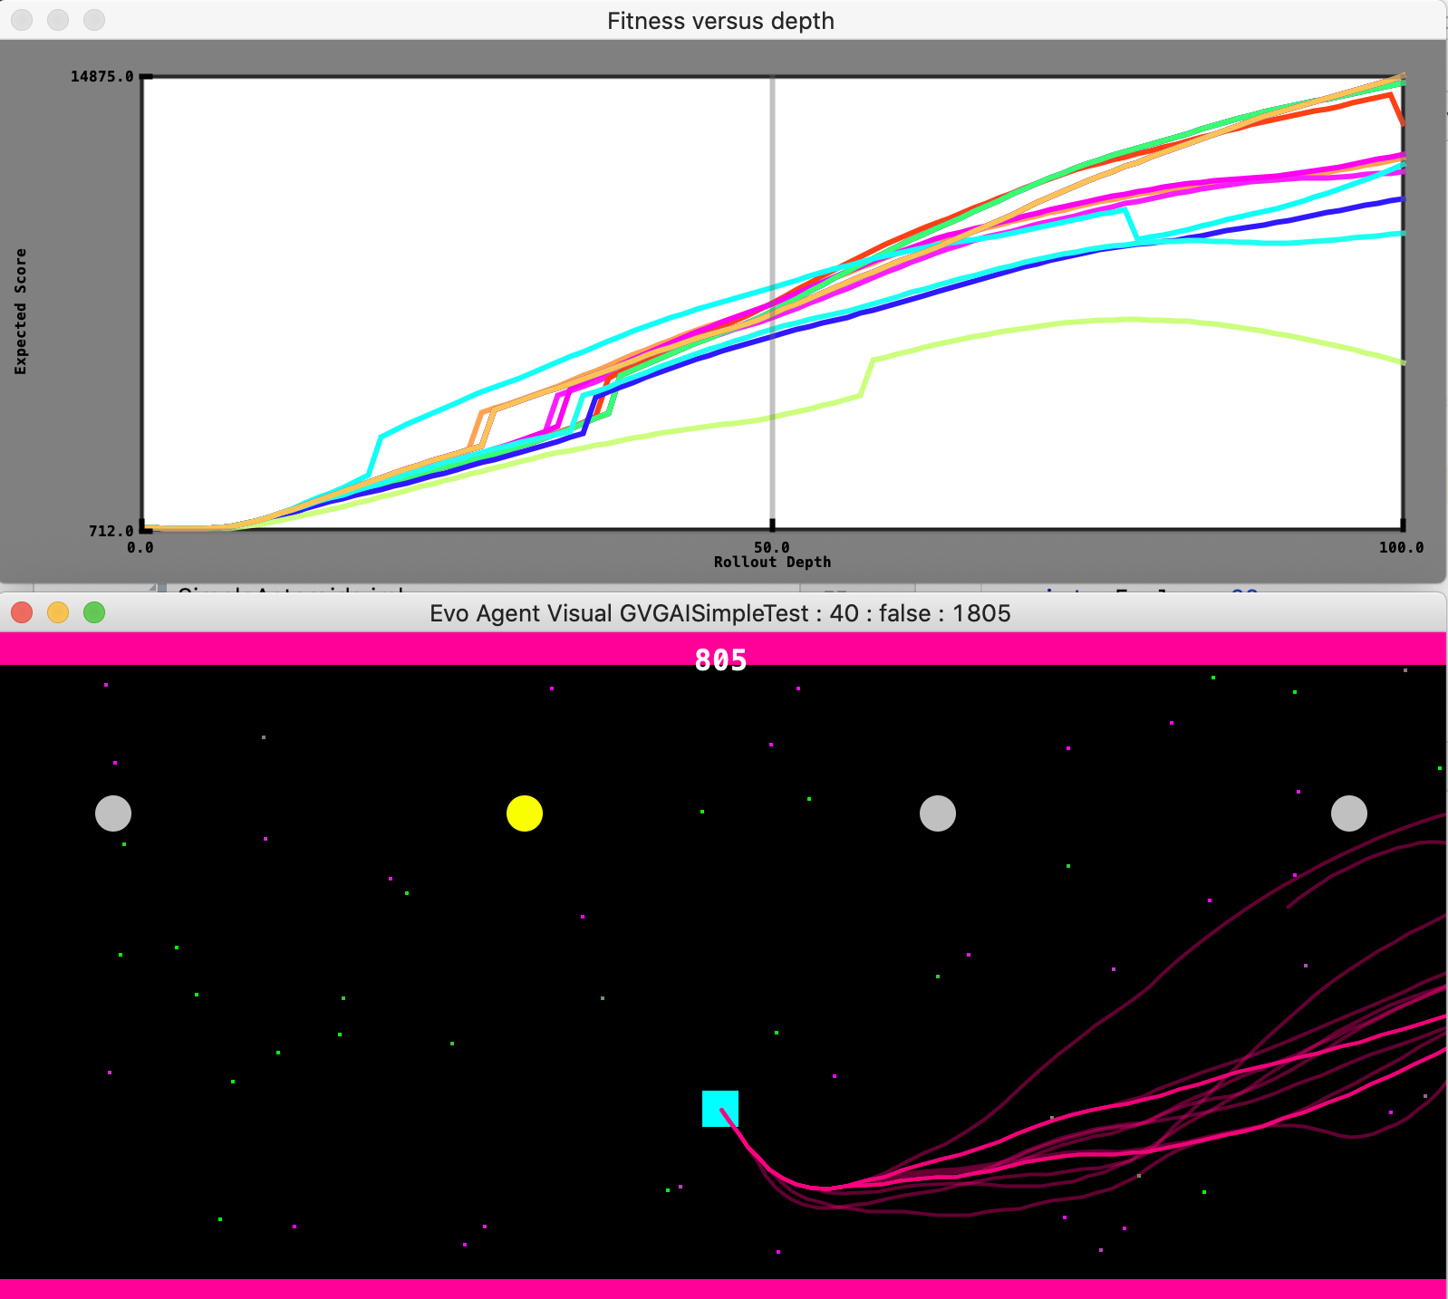
Statistical Forward Planning: The Concept
To make a decision:
Take copies of the current simulated world state (model)
Optimise a sequence of actions
To choose an action that is likely to lead to a good outcome
The Model Can even be WRONG!
Yet still be useful:
Just need sufficient RANK correlation between predicted and actual rewards

Slide 5
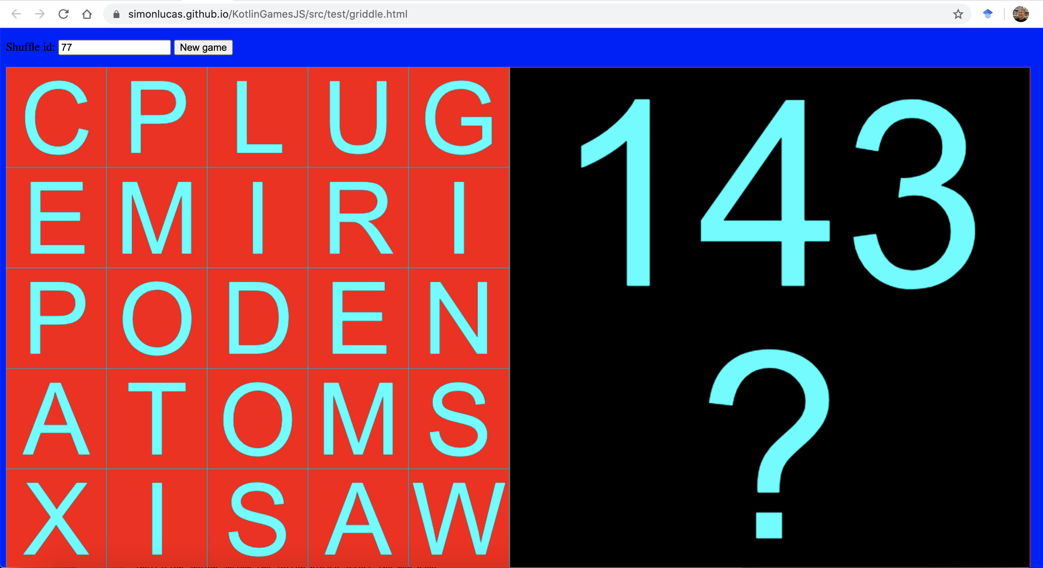

Griddle on the web – play against the AI https://simonlucas.github.io/XKG/src/jsMain/kotlin/sample/griddle.html
Simple word game
Deck of 75 cards
Made to be nice
e.g. 5 x E, 1 x Z
Select a shuffle via Random seed
After each letter is dealt
place in the grid
Words made like a cross word
10 points for 5 letter
7 for 4 letter
3 for 3 letter
1 point for 2 letter
Integrated Monte Carlo AI
Click in the black area for AI to play
The AI does NOT cheat (no knowledge of shuffle)

Slide 6
Summary
SFP is an amazing concept
Works well across a wide range of games
Real-world applications: great challenge
Need a forward model; no need to be perfect
Real-world applications are often messy, and no need to be optimal
So much to explore, especially MCSG

